Slide 1
Technology In Sports
Vincent Cristantiello

Slide 2
What kind of technology do sports have
They have wearable tech
Video Replay like VAR and Challenges
Virtual Reality
Radar Technology – trackman

Slide 3
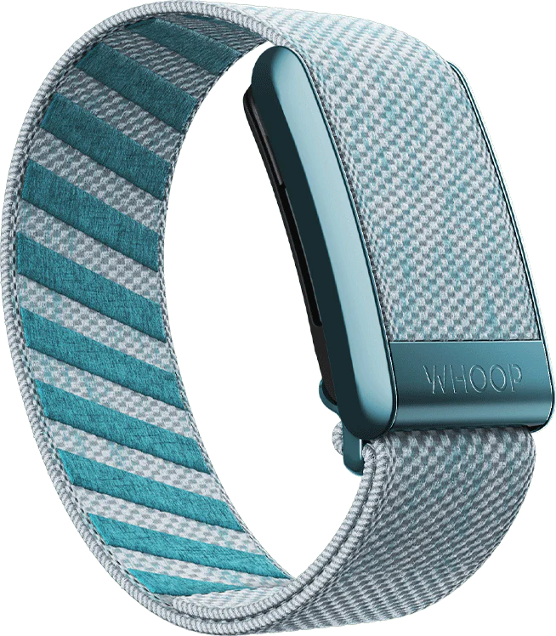
Wearable Tech
Whoop is a wearable that tracks sleep, body strain, body recovery and is mainly used by athletes
It tracks sleep by monitoring change in heart rate and respiratory rate
It tracks body strain by measuring cardiovascular and muscular load

Slide 4
Wearable Tech
Whoop is a wearable that tracks sleep, body strain, body recovery and is mainly used by athletes
It is used by athletes because it can detect their stress levels and in game muscular strain
They can then use this data to change their approach for the next game or practice

Slide 5
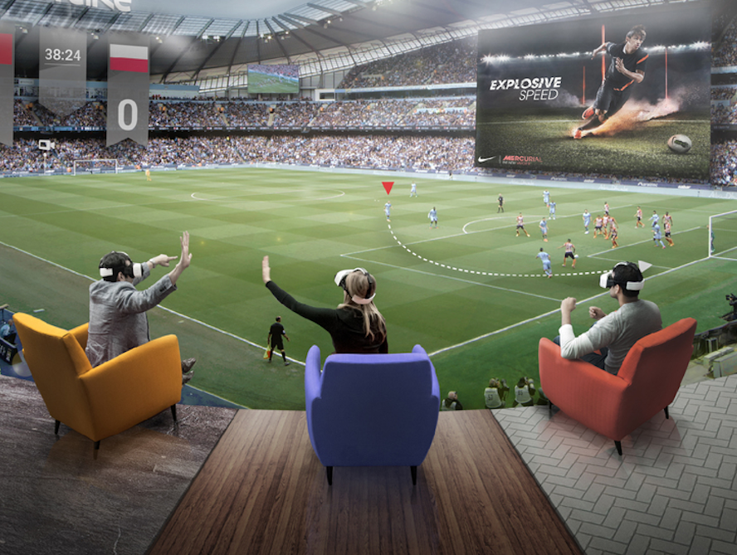
Virtual Reality
Virtual reality is being used in sports from training for golf, skiing, cycling and watching at home front row for fans
VR is being used in golf by wearing a VR system and using many cameras to record their swing. This is then looked over by professionals to tweak their swing to make it better

Slide 6
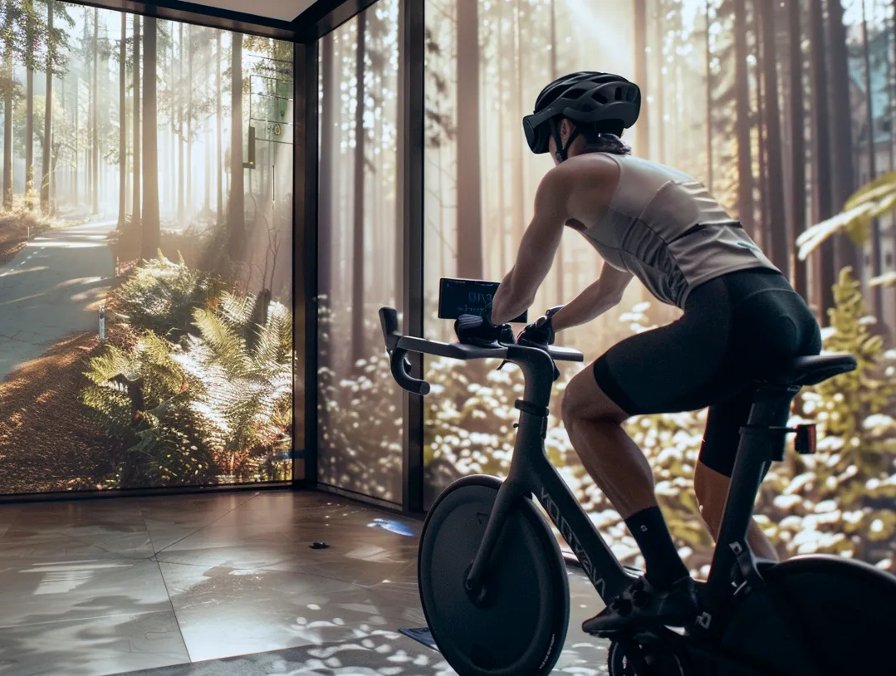
Virtual Reality
Virtual reality is being used in sports from training for golf, skiing, cycling and watching at home front row for fans
VR is used for skiing by also having a headset on and it simulates the person on a ski slope with technology that feels like they are actually skiing on real snow out on a mountain
VR is used in cycling just like the others but this time using a stationary bike almost like a peloton

Slide 7
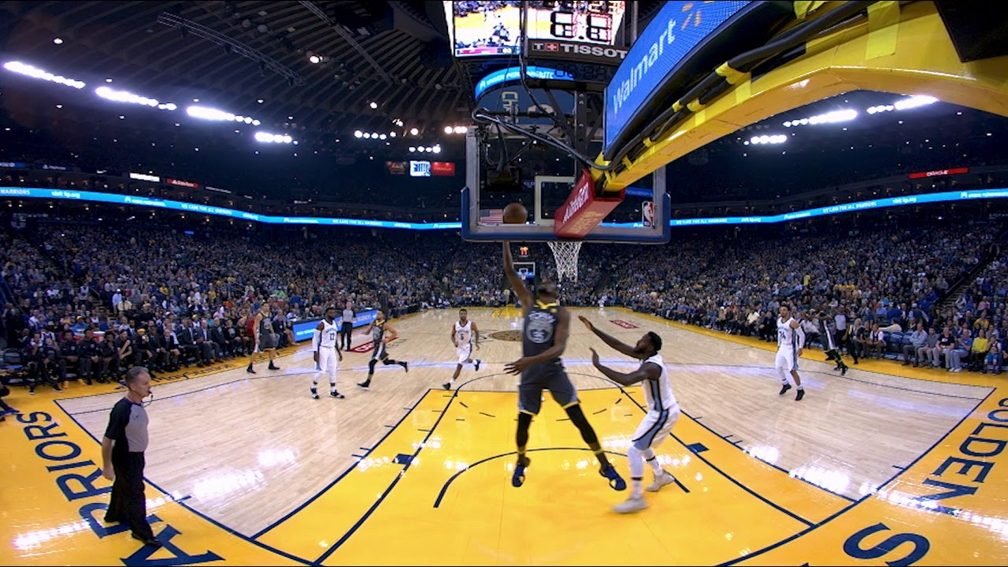
Virtual Reality
Virtual reality is being used in sports from training for golf, skiing, cycling and watching at home front row for fans
VR is being used in basketball by having fans be able to sit front row at any game they want to. All they have to do is buy a membership through the Xtadium app and have a VR headset and then they can watch any live game from their house but be in a front row seat.

Slide 8
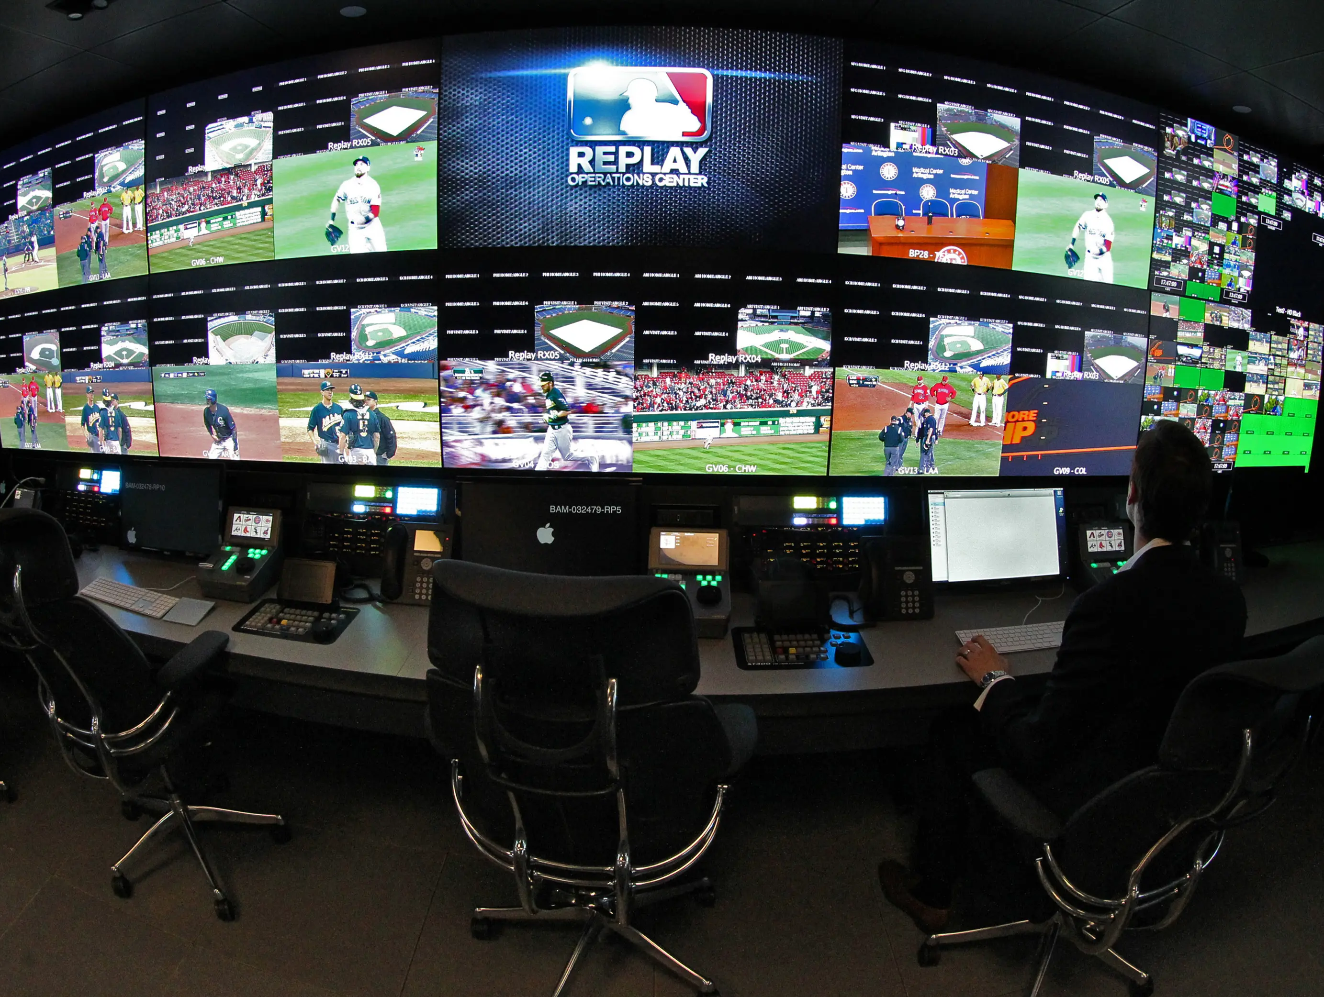
Video replay
Video replay is being used in lots of different sports. They are being used in baseball, soccer and football
Specifically for baseball if a player doesn’t agree with a call, they have the option to challenge the call. The manager would then signal to the umpire to “challenge the play”. The umpires then get together and listen to a crew in the replay command center in New York to look over the play and overturn it or to leave the call alone and not change it.
Not all calls can be looked over but most in play calls can be. For example, a call that can’t be looked over yet is a ball or strike call but something like a out or safe call on the field can be looked over.

Slide 9
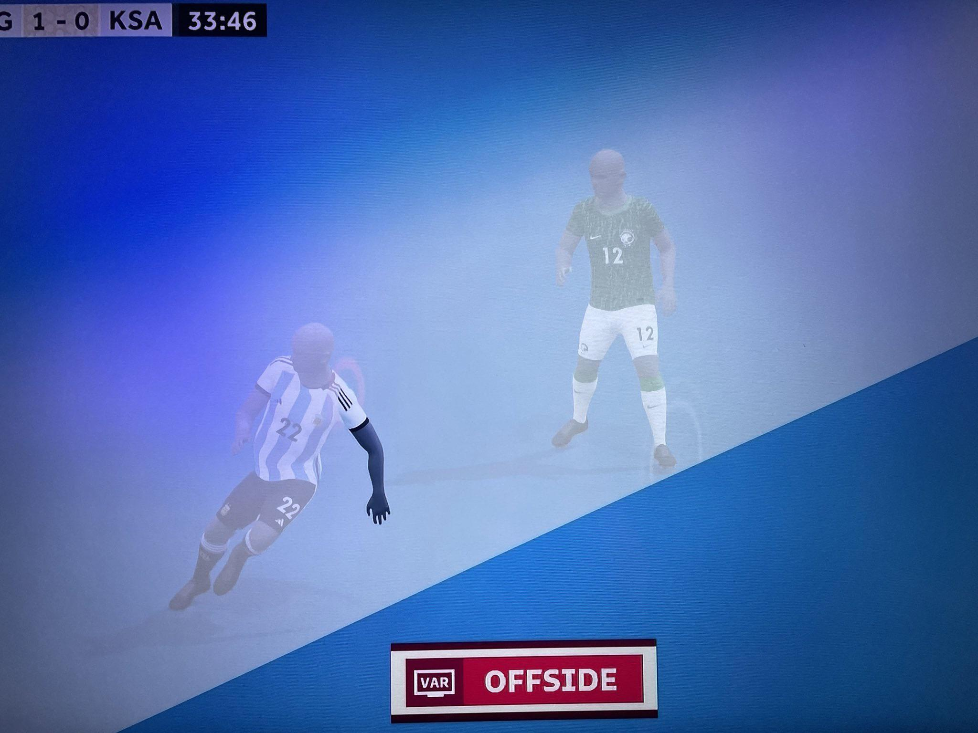
Video replay
Video replay is being used in lots of different sports. They are being used in baseball, soccer and football
For soccer the video replay is commonly called VAR “Video Assisted Referee”.
It usually overlooks offside calls, red/yellow card calls and goals.
Unlike baseball a manager/coach can’t tell a referee to look at VAR it is only up to the main center ref to make that decision

Slide 10
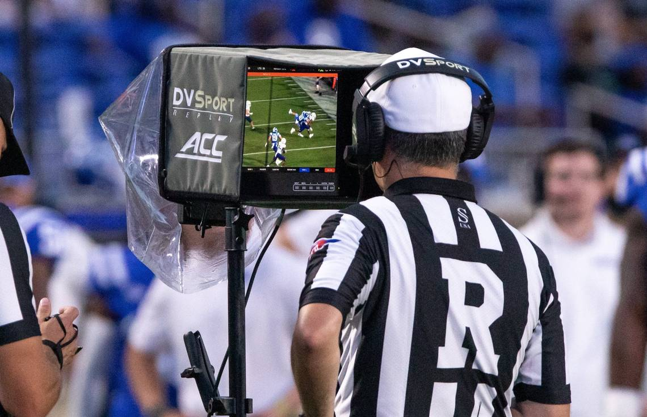
Video replay
Video replay is being used in lots of different sports. They are being used in baseball, soccer and football
Replay is also used in football almost how it is used in baseball. It is used to make sure the on field referees made the call correct
The referees only have 90 seconds to look over the play to determine if the call was correct or wrong

Slide 11
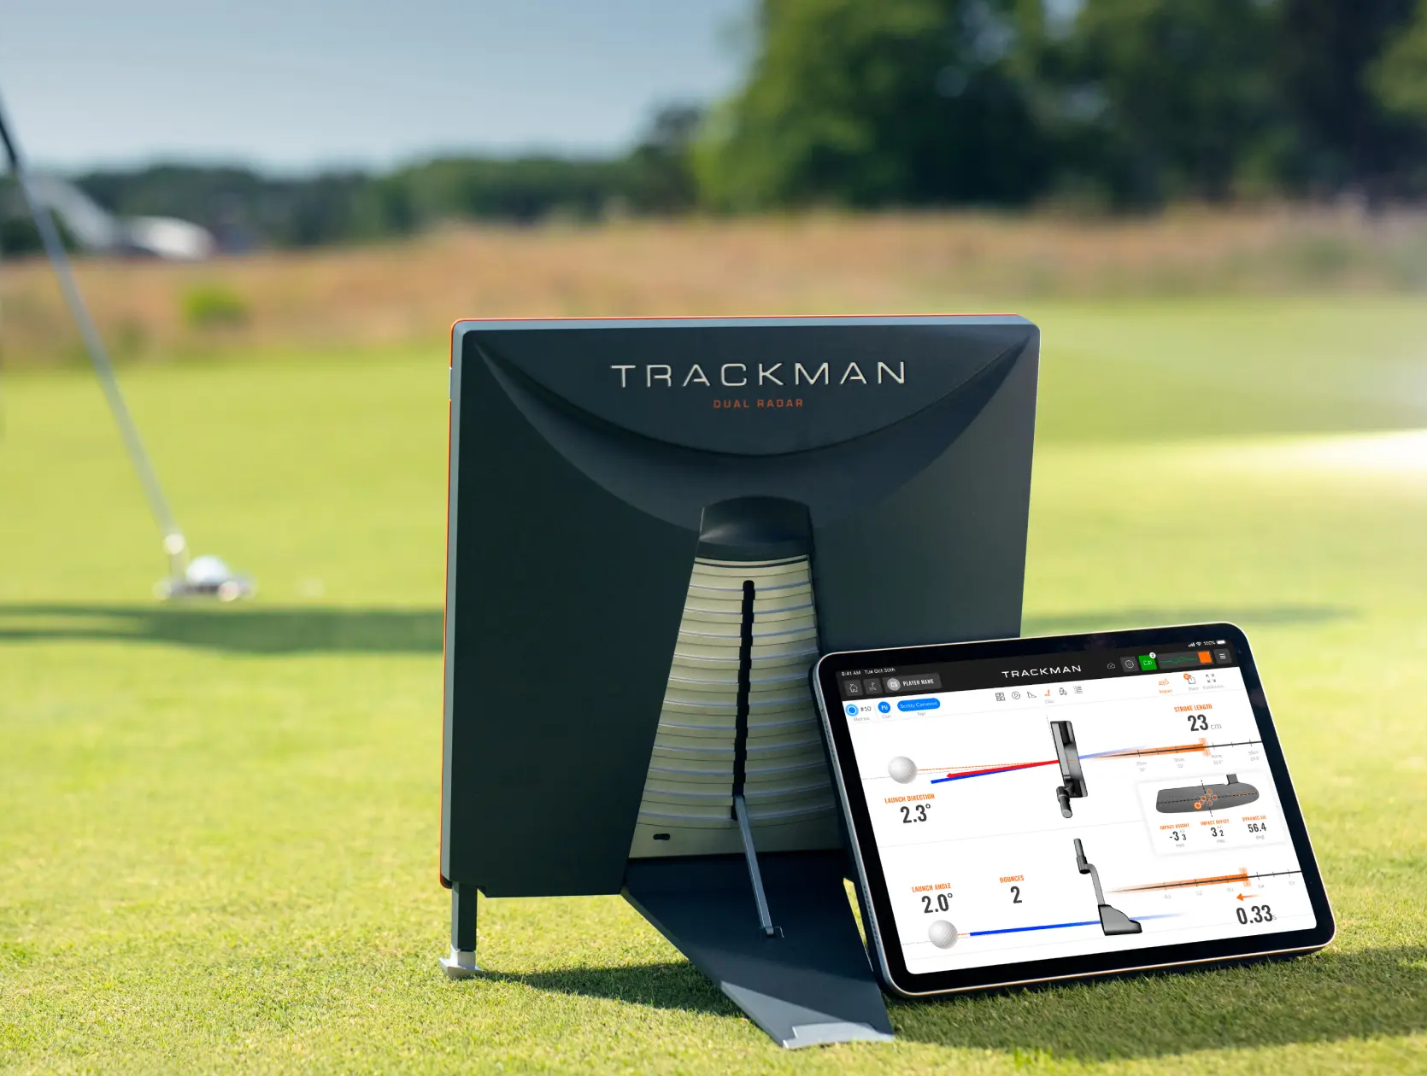
Radar tech
Radar is used mainly in golf and baseball
Radar is used in golf by tracking the ball flight, carry distance, ball speed, and swing speed
These are all very important to professional golfers because when they approach their ball, they need to know everything about their swing to make sure they hit the ball the best way and have the ball land in the best possible place.

Slide 12

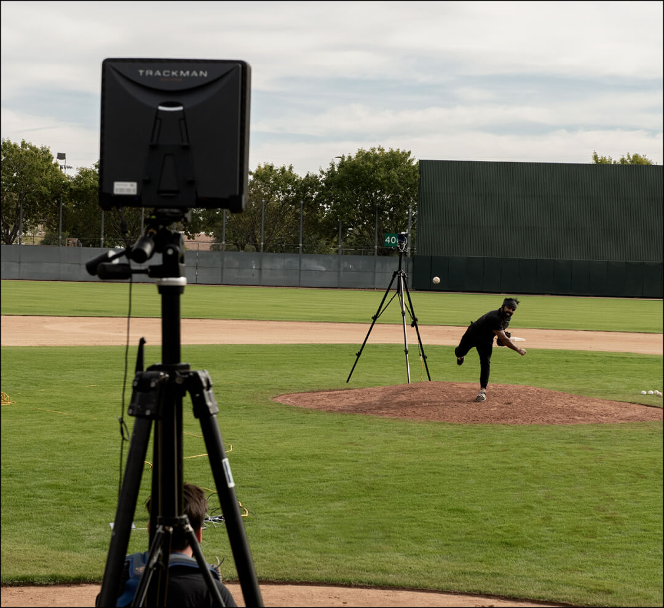
Radar tech
Radar is used mainly in golf and baseball
Radar is used in baseball reading the spin rate, exit velocity when the ball is hit, home run distance pitch velocity and pitch movement
All of these are important to professional and college level athletes because they have to know what pitch to throw and when to throw it to make sure the pitcher gets outs.

Slide 13


